Slide 1
Chapter 1. Introduction to Data Communications
Business Data Communications and Networking Fitzgerald and Dennis, 7th Edition
Copyright © 2002 John Wiley & Sons, Inc.

Slide 2
Copyright © 2002 John Wiley & Sons, Inc. All rights reserved. Reproduction or translation of this work beyond that named in Section 117 of the United States Copyright Act without the express written consent of the copyright owner is unlawful. Requests for further information should be addressed to the Permissions Department, John Wiley & Sons, Inc. Adopters of the textbook are granted permission to make back-up copies for their own use only, to make copies for distribution to students of the course the textbook is used in, and to modify this material to best suit their instructional needs. Under no circumstances can copies be made for resale. The Publisher assumes no responsibility for errors, omissions, or damages, caused by the use of these programs or from the use of the information contained herein.

Slide 3
Chapter 1. Learning Objectives
Be aware of the history of communications, information systems and the Internet
Be aware of the applications of data communications networks
Be familiar with the major components of and types of networks
Understand the role of network layers
Be familiar with the role of network standards
Be aware of three key trends in communications and networking

Slide 4
Chapter 1. Outline
Introduction: The Information Society
Brief histories of:
  communications, info systems and the Internet
Data Communications Networks
  network components, network types
Network Models
  OSI model, Internet model, message transmission using layers
Network Standards
  importance of standards, standards making, common standards
Future Trends
  pervasive networking, integration of voice, video, and data, new information services

Slide 5
Introduction: The Information Society

Slide 6
The Information Age
Human economic activity can be divided into three broad epochs:
  1. The long period in which agricultural and other types of subsistence activities dominated
  2. The period since the industrial revolution (ca. 1780) in which machines began to replace human labor
  3. The “Information Age” in which human activities are increasingly dependent on the storage and flow of vast amounts of information.

Slide 7
Information Economics
Historically, we can say that economic activity is due to the effects of three factors:
  1. Land
  2. Labor (strategic preindustrial resource)
  3. Capital (strategic resource of the industrial age)
With the rise of information technologies, information must now be viewed as a fourth, strategically important economic factor.
Information is used to determine how the other three factors are best allocated and has value in and of itself.

Slide 8
The Collapsing Information Lag
Electronic communications has greatly sped up the rate of transmission of information, beginning with the telegraph in the 1840s.
Information that took days or weeks to be transmitted during the 1700s could be transmitted in minutes or hours by 1900.
Today, telecommunications networks transmit huge quantities of information in a fraction of a second.
In fact, the growth of telecommunications and especially computer networks has been the strongest contributor to the globalization phenomenon we are experiencing today.

Slide 9
A Brief History of Communications in North America

Slide 10
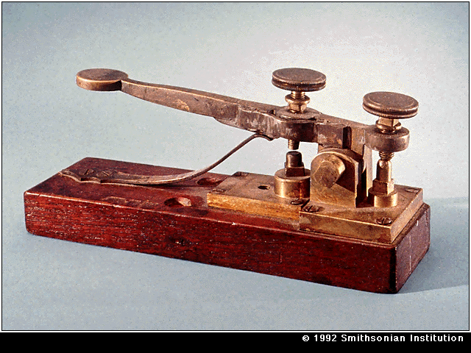
North American Communications: A Brief History (see Figure 1-1)
1837 Invention of the telegraph by Samuel Morse

Slide 11
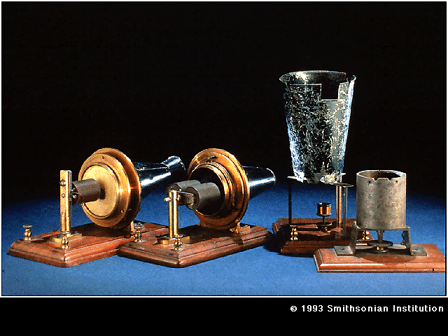
1876 Invention of the telephone by Alexander Graham Bell

Slide 12

1892 Canadian Government starts regulating telephone system
1910 US Government begins to regulate telephone system
1915 Transcontinental and transatlantic phone service begins
1951 Direct-dialed long distance service begins
1962 Telstar satellite starts relaying international phone calls

Slide 13
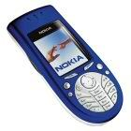
1968 Carterfone decision allows use of non-Bell equipment
1970 MCI permitted to provide long distance services
1984 The Modified Final Judgment: AT&T broken up; long distance market deregulated
1984 Cell phones come into service
1996 US Telecom Act: local telecom markets deregulated

Slide 14
20th Century Advances in Phone Technology
1915: 1st transcontinental and transatlantic phone connections.
1919: The Strowger (stepper) switch began to be used, along with rotary dial phones, enabling automatic connections.
1948: Microwave trunk lines first put in service in Canada.
1962: Telecommunications via satellite began with Telstar. Fax services and digital transmission (T-carriers) also introduced
1969: Picturefone services introduced but fail commercially
1976: Packet-switched data communications begins
1984: Cellular telephone communications begins

Slide 15
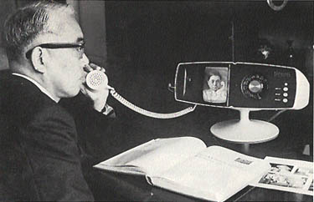
Picture Phone

Slide 16
The Telephone: from Invention to Regulation
In many ways, the late 19th century was like the late 20th century: a time of technological change and invention.
Invented in 1876, telephone use grew rapidly. By 1900, millions of phones were in use in the U.S.
By 1910, the Bell System had become a de facto monopoly. Its president argued that it was a “natural monopoly”.
Telephone regulation began in 1892 in Canada and 1910 in the US.
In 1934, the FCC was established in the US to regulate interstate the telephone business.

Slide 17
Deregulating the Telephone Industry 1968-1984
1968: Carterfone court decision allowing non-Bell customer premises equipment
1970: MCI wins court case; begins providing some long distance services
1984: Results of consent decree by US federal court:
  1.Divestiture: AT&T was broken up into a long distance company (AT&T) & 7 Regional Bell Operating Companies (RBOCs).
  2. Deregulation: the long distance (IXC, interexchange carrier) market became competitive. MCI & Sprint enter LD market (among others).
  (Note that local exchange service (LEC) markets remained an RBOC monopoly service).

Slide 18
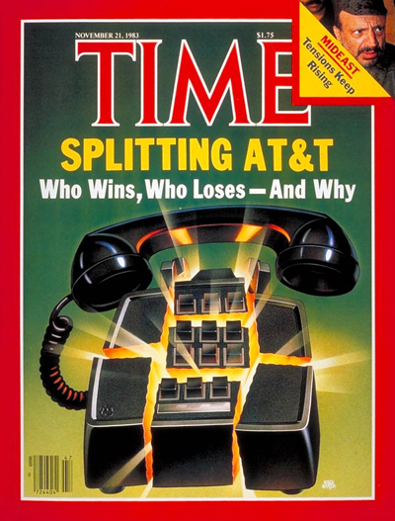

Slide 19
1996: US Telecom Competition and Deregulation Act
http://www.fcc.gov/telecom.html
Act replaces all current laws, FCC regulations, 1984 consent decree, and overrules state laws
Main goal was opening local markets to competition. To date, though, local competition has been slow to take hold…
  Large IXCs were expected to move into the local markets, but this has not yet happened
  Likewise, RBOCs were expected to move into long distance markets, but they are prohibited from doing so before competition begins in local markets

Slide 20
Competitive Telecom Markets: A Worldwide Trend
The Internet market is extremely competitive with 5000 Internet Service Providers in the US alone. Heavy competition in this area may lead to a shake out in the near future.
In 1997, a World Trade Organization agreement included commitments by 68 countries to open, deregulate or lessen regulation in their telecom markets.

Slide 21
A Brief History of Information Systems

Slide 22
A Brief History of Information Systems
1950s: Batch processing mainframes
1960s: Data communications over phone lines became common and mainframes became multi-user systems
1970s: Online real-time, transaction oriented systems replaced batch processing. DBMSs become common
1980s: The PC revolution
1990s: PC LANs become common
2000: Networking everywhere

Slide 23
IS and Business: Wal-Mart vs. Macy’s
Macy’s: bankrupt in the early 1990s. Partly due to an inability to keep close track of inventory. Macy’s lack of an up-to-date inventory system resulted in long restocking delays and lost sales.
Wal-Mart in contrast uses huge numbers of computers: 34 mainframes, 5000 network file servers, 18,000 PCs, 90,000 handheld inventory computers and 100,000 networked cash registers.
Wal-Mart’s greater command of information over sales allowed a more sophisticated approach to purchasing, resulting in lower prices for its goods and increased sales.

Slide 24
A Brief History of The Internet http://www.isoc.org/internet/history

Slide 25
Internet Milestones
Originally called ARPANET, the Internet began in 1969 as a military-academic network in the US (originally 4 nodes).
1983, Milnet (for military) split off. Internet is used for academic, education and research purposes only
1986 NSFNet created as US Internet backbone
Early 1990s, commercial access to the Internet begins. Government funding of the backbone ends in 1994.
As of early 2001, the Internet had an estimated 40 million servers and 400 million users. Growth in the use of the Internet continues at a rapid rate

Slide 26
Internet Domain Names
Format = computer name(s) + domain name:
  computer.domain or computer.computer.domain
  for example, http://auckland.massey.ac.nz/
Domain names are strictly controlled to prevent duplication
Initially, when the Internet existed exclusively in the US, six top level domains were available:
  .edu, .com, .gov, .mil, .org and .net
As the Internet has become a global network, international top level domains have been added using two letter country codes such as:
  .ca, .au, .uk, .de, .nz
  http://www.iana.org/cctld/cctld-whois.htm

Slide 27
Data Communications Networks

Slide 28
Datacom Basics
Data Communications: the movement of computer information from one point to another by means of electrical or optical transmission systems (called networks).
Telecommunications: broader term that includes the transmission of voice and video, as well as data, and may imply longer distances.
Although once considered separate phenomenon, telecom & datacom are in the process of “converging” into a single “broadband” communications technology.

Slide 29
Network Components
Local area networks contain three basic hardware components (see Figure 1-1):
  Servers (also called hosts or host computers)
  Clients
  Circuits
Clients and Servers typically work together in client-server networks. Networks without servers are called peer-to-peer networks.
Routers are specialized devices responsible for moving information between networks, are also a common network component.
Server types: file servers, print servers, Web servers, e-mail and directory servers.

Slide 30
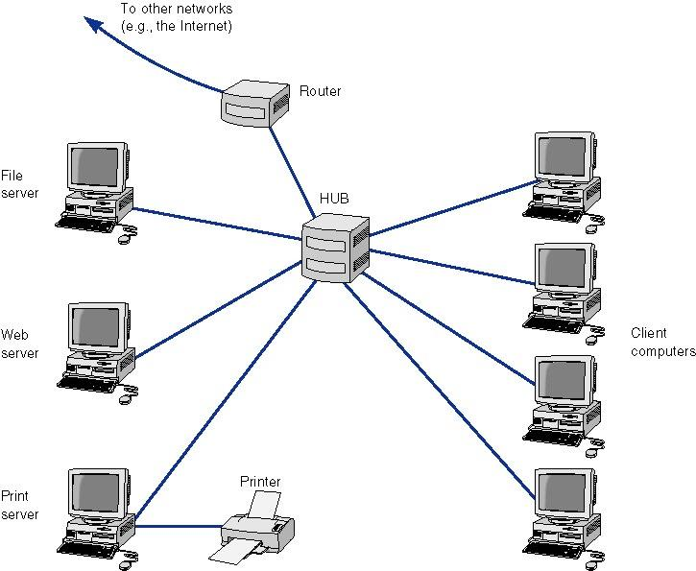
Figure 1-1. Components of a Network

Slide 31
Network Types (Figure 1-2)
A common way of thinking about networks is by the scale of the network. 4 common network types are:
  Local Area Networks (LANs) which typically occupy a room or building, usually include a group of PCs that share a circuit.
  Backbone Networks, have a scale of a few hundred meters to a few kilometers. Include a high speed backbone linking the LANs at various locations.
  Metropolitan Area Networks (MANs) which typically have a scale of a few kilometers to a few tens of kilometers & connects LANs and BNs at different locations, often using leased lines or other commercial services to transmit data.
  Wide Area Networks (WANs) have a scale of hundreds or thousands of kilometers. Like MANs, leased circuits or other commercially available services are used to transmit data.

Slide 32
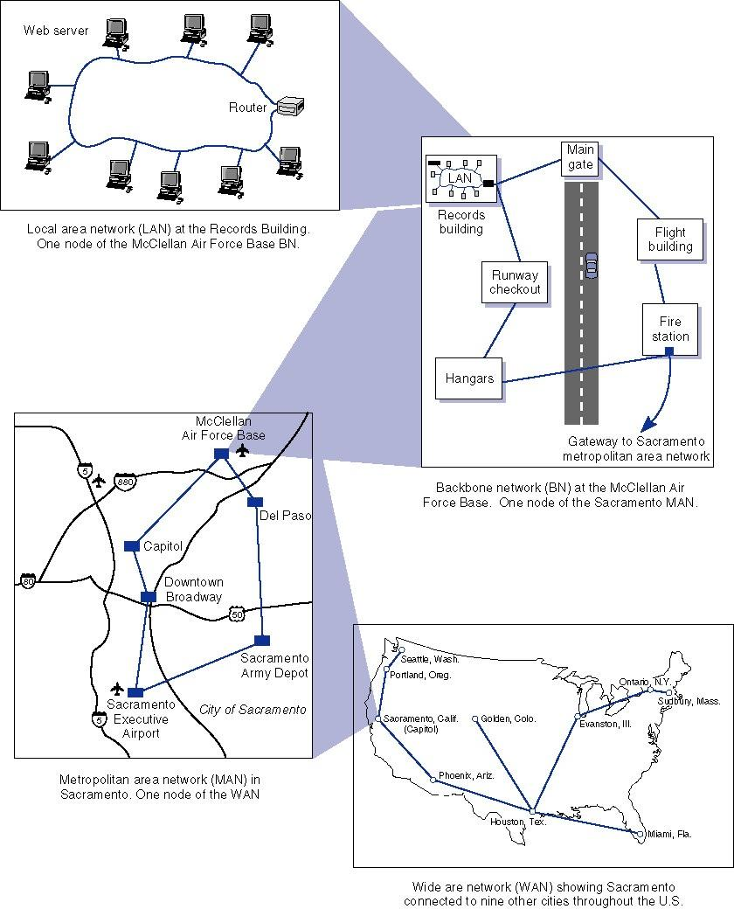
Figure 1-2. Network Types by Scale

Slide 33
Intranets and Extranets
Intranets are networks that have been set up so that Web sites or other applications can be used over private networks.
Extranets also use Internet technology by providing customer access to secure corporate Web sites. Extranet access is usually controlled using passwords, but newer technologies such as smart cards are also being used.

Slide 34
Network Models

Slide 35
Multi-layer Network Models
The process of transferring a message between sender and receiver is more easily implemented by breaking it down into simpler components.
Instead of a single layer, a group of layers are used, dividing up the tasks required for network communications.
The two most important such network models are the OSI and Internet models.

Slide 36
The OSI Networking Reference Model
Stands for Open Systems Interconnection
Created by the International Standards Organization (ISO) as a framework for computer network standards
Released in 1984, the model has 7 layers (see Figure 1-3).

Slide 37
The OSI 7-layer Model
Application: provides a set of utilities used by application programs
Presentation: formats data for presentation to the user, provides data interfaces, data compression and translation between different data formats
Session: responsible for initiating, maintaining and terminating each logical session between sender and receiver
Transport: deals with end-to-end issues such as segmenting the message for network transport, and maintaining the logical connections between sender and receiver
Network: responsible for making routing decisions
Data Link: deals with message delineation, error control and network medium access control
Physical: defines how individual bits are formatted to be transmitted through the network

Slide 38
The Internet (TCP/IP) Protocol Suite
Stands for Transmission Control Protocol/ Internet Protocol. Used on the Internet.
TCP/IP’s 5 layer suite was developed to solve to the problem of internetworking
Network layers can also be placed in three groups:
  application layer (includes the application layer),
  internetwork layer (includes the transport and network layers)
  hardware layer (includes the data link and physical layers).
See Figure 1-3.

Slide 39
The Internet’s 5-Layer Model
Application: used by application program
Transport: responsible for establishing end-to-end connections, translates domain names into numeric addresses and segments messages
Network*: responsible for end-to-end addressing and routing, determines destination address if unknown
Data Link*: deals with message delineation, error control & network access
Physical*: defines how information will be transmitted through the network
*same as corresponding layer in OSI model

Slide 40
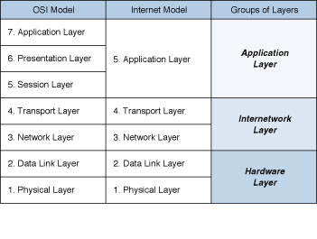
Figure 1-3: Network Models

Slide 41
Message Transmission Using Layers
(Figure 1-4)
Network model layers use protocols, i.e., sets of rules to define how to communicate at each layer and how to interface with adjacent layers.
Generally, messages travel down all network layers.
When a message is sent to the next layer, that layer places it in an envelope and adds addressing information related to that layer.
At the receiving end, messages travels up through the network layers, each layer removing the envelopes added when the message was sent.

Slide 42
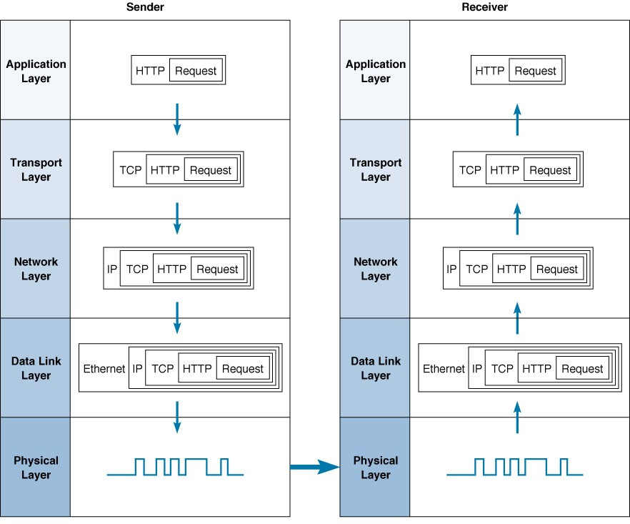
Fig. 1-4 Message transmission using layers

Slide 43
Networking Example: clicking on a WWW hyperlink
Clicking on a hyperlink starts an HTTP request-response cycle. First, the user’s browser sends an HTTP request.
The HTTP request is then handed to the transport layer’s TCP protocol and placed in a TCP segment.
The TCP segment is placed in an IP (network layer) packet.
The IP packet is next placed in a Data Link layer (such as Ethernet) frame and sent out over the network media as a series of 1s and 0s defined by the physical layer.
On the web server, this process occurs in reverse, each layer removing the overhead information added by each layer until the HTTP request is finally produced for the server to read.
The server then sends an HTTP response back to the client which is sent back to the user’s browser.

Slide 44
Network Standards

Slide 45
Why Standards?
Standards provide a fixed way for hardware and/or software systems to communicate.
For example, USB enables two pieces of equipment to interface even though they are manufactured by different companies.
By allowing hardware and software from different companies to interconnect, standards help promote competition.

Slide 46
Types of Standards
There are two main types of standards:
Formal: a standard developed by an industry or government standards-making body
De facto: standards that emerge in the marketplace and are widely used, but lack official backing by a standards-making body

Slide 47
The Standardization Processes Three Steps
Specification: developing the nomenclature and identifying the problems to be addressed.
Identification of choices: identify solutions to the problems and choose the “optimum” solution.
Acceptance: defining the solution, getting it recognized by industry so that a uniform solution is accepted.

Slide 48
Some Major Standards Making Bodies
ISO: International Organization for Standardization (www.iso.ch)
ITU-T: International Telecommunications Union –Telecom Group (www.itu.int)
ANSI: American National Standards Institute (www.ansi.org)
IEEE: Institute of Electrical and Electronic Engineers (see standards.ieee.org)
IETF: Internet Engineering Task Force (www.ietf.org)

Slide 49
Fig. 1-5. Some data communications standards
Layer
Common Standards
5. Application layer
HTTP, HTML (Web)
MPEG, H.323 (audio/video)
IMAP, POP (e-mail)
4. Transport layer
TCP (Internet)
SPX (Novell LANs)
3. Network layer
IP (Internet)
IPX (Novell LANs)
2. Data link layer
Ethernet (LAN)
PPP (dial-up via modem)
1. Physical layer
RS-232c cable (LAN)
Category 5 twisted pair (LAN)
V.92 (56 kbps modem)

Slide 50
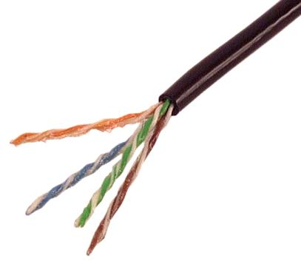
Twisted Pair

Slide 51
Future Trends

Slide 52
Three Emerging Trends in Networking
Pervasive Networking
The Integration of Voice, Video and Data
New Information Services

Slide 53
Pervasive Networking
The pervasive networking means:
  network use will continue to grow exponentially
  network access is everywhere
  many new types of devices will have network capability
Data rates for all kinds of networking will also continue to grow exponentially, reaching Gigabit per second ranges later in this decade (see Figure 1-6)

Slide 54
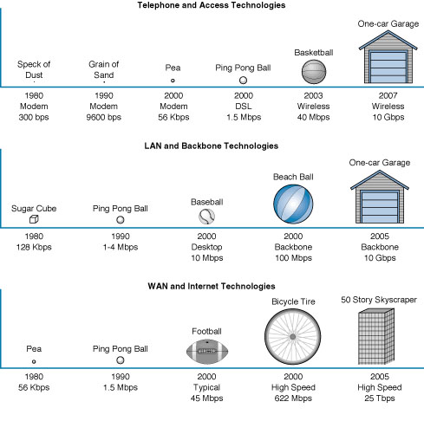
Figure 1-6: Relative Capacities of telephone, LAN, BN, WAN, and Internet circuits.

Slide 55
The Integration of Voice, Video & Data
Also called convergence, integration means that telecom systems that were previously transmitted using separate networks will merge into a single, high speed, multimedia network in the near future.
The first step is the integration of voice and data, which is already underway.
Later, video will merge with voice and data. This step will take longer partly due to the high data rates required for video.

Slide 56
New Information Services
With the World Wide Web, many new types of information services becoming available.
Another trend is the growth of Application Service Providers (ASPs) that develop systems for companies, such as providing and operating a payroll system for a company that does not have one of its own.

Slide 57
Next Day Air Service Case Study

Slide 58
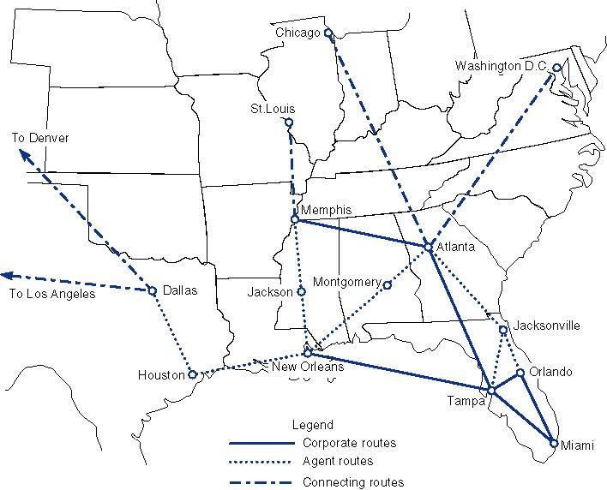
Figure 1-7: Next Day Air Service map of operations

Slide 59
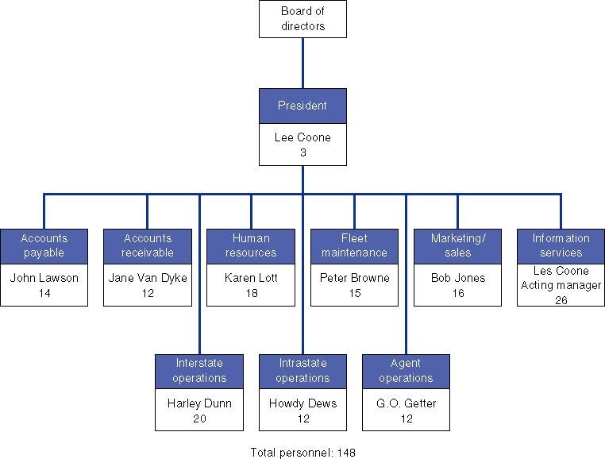
Figure 1-8: Next Day Air Service organization chart showing key personnel and number of staff per area.

Slide 60
End of Chapter 1

